Slide 1


AUTONOMOUS ROBOT WITH ARM FOR WAREHOUSE APPLICATION
AY 2024-25
GITAM UNIVERSITY
Major Project
Project ID: CSP21
A University should be a place of light, of liberty, and of learning.
Department of Electrical Electronics and Communication Engineering
Project Team:
SUHAS S
PRAJWAL S
NAVATEJ M B
Project Mentor:
Dr. PRITHVI SEKHAR PAGALA
www.gitamedu.com

Slide 2




Project Group – Details
Photo
Track
Roll No
Name
EEE
BU21EECE0200034
SUHAS S
EEE
BU21EECE0200035
PRAJWAL S
EEE
BU21EECE0200037
NAVATEJ M B

Slide 3
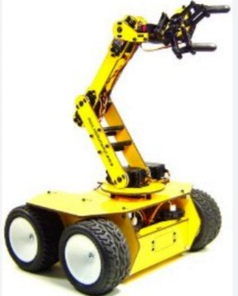
Objective and Goals
Objective
The goal of creating an autonomous robot with an arm for warehouse use is to make warehouse operations more efficient, accurate, and safe. This robot would automate tasks like picking, packing, and sorting items, reducing the need for manual labor and minimizing errors. By handling repetitive and potentially dangerous jobs, the robot can help lower labor costs, improve space utilization, and enhance overall productivity. Additionally, it can collect valuable data to help manage inventory better and speed up order fulfillment, ultimately leading to improved customer satisfaction and a more streamlined warehouse operation.
Goals
Main Goals
Increase Efficiency
Improve Safety
Reduce Labor Costs
Support Scalability
Boost Customer Satisfaction
Additional Goals
Enable Flexibility
Facilitate Easy Maintenance
Reduce Environmental Impact

Slide 4
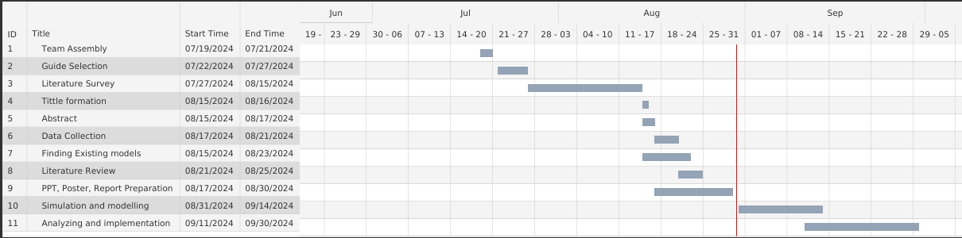
Project Plan
Gant Chart - Milestones and Activities

Slide 5
Literature Survey
Key Publications
Liang, C., et al. "Automated robot picking system for e-commerce fulfillment warehouse application." The 14th IFToMM World Congress. Vol. 1. 2015.
Prakash, Ravi, et al. "Dual-loop optimal control of a robot manipulator and its application in warehouse automation." IEEE Transactions on Automation Science and Engineering 19.1 (2020): 262-279.
Khan, Muhammad Aqib. Design and control of a robotic system based on mobile robots and manipulator arms for picking in logistics warehouses. Diss. Normandie Université, 2020.
Key Resources – Whitepaper| Notes | Datasheet| Others
Cosma, Claudio, et al. "An autonomous robot for indoor light logistics." 2004 IEEE/RSJ International Conference on Intelligent Robots and Systems (IROS)(IEEE Cat. No. 04CH37566). Vol. 3. IEEE, 2004.
Kimura, Nobutaka, et al. "Mobile dual-arm robot for automated order picking system in warehouse containing various kinds of products." 2015 IEEE/SICE International Symposium on System Integration (SII). IEEE, 2015.
Existing Implementations – Products| Opensource| GitHub
https://thinkrobotics.com/products/armpi-pro-ros-robot-chassis-with-robot-arm?variant=44733277765949&currency=INR&utm_medium=product_sync&utm_source=google&utm_content=sag_organic&utm_campaign=sag_organic&utm_source=googleads&utm_medium=cpc&gad_source=1&gclid=CjwKCAjw2dG1BhB4EiwA998cqDfmuh1hbGvURlhMEQtT86G7gZ0X3DSSziC_0j6ujQZA7ki02fXRWRoCuDgQAvD_BwE
https://youtu.be/LBNRGBY5zN8?si=a5Wrnj9VyQpgp9ZF

Slide 6
Analysis - SWOT
Weaknesses
Strengths
W1. Limited flexibility
W2. Higher Capital Cost
W3. Complex Implementation
W4. Dependence on Technology
S1. High Efficiency
S2. Reduce Labor Cost
S3. Improve Safety
S4. 24/7 operation
Opportunities
Threats
T1. Technological failures
T2. hardware failures
T3. Labor relations
O1. Scalability
02. Technological advancements
O3. Market competitiveness

Slide 7
Analysis – 4W1H
Why: Using a warehouse management robot offers several significant advantages that can improve overall productivity in a warehouse environment. To enhance the efficiency, speed, improved accuracy, 24/7 operation, reliability, sustainability of warehouse management and better space utilization.
What: An Autonomous Robot with an arm for warehouse management is a sophisticated robotic system designed to operate independently within a warehouse environment. It combines autonomous navigation capabilities with a robotic arm to perform a variety of tasks, such as picking, placing, sorting, and handling goods.
Where: An Autonomous Robot with an arm for warehouse management can be used in a wide range of applications across different industries and warehouse environments. Such as E-commerce fulfillment centers, Retail distribution centers, Manufacturing warehouses, Third-party logistics providers,
When: Deploying an Autonomous Robot with an arm for warehouse management is beneficial when dealing with high order volumes, repetitive tasks, complex inventory, safety concerns, and cost efficiency. It is also advantageous when flexibility, real-time data, and customer expectations are key factors. By assessing these conditions, businesses can determine the optimal time and context for implementing robotic automation in their warehouse operations.
How: To implement an Autonomous Robot with an arm in warehouse management, first assess your operations to identify key areas where the robot can add value, such as picking or inventory management. Next, set up and program the robot to navigate and perform tasks efficiently, and integrate it with your existing warehouse management system (WMS) for seamless operation. Finally, monitor its performance, optimizing its tasks and making adjustments.
Refined Objective: To develop a cost efficient autonomous robot for warehouse management to increase overall productivity and reduce errors by manual labour and offer significant efficiency.

Slide 8
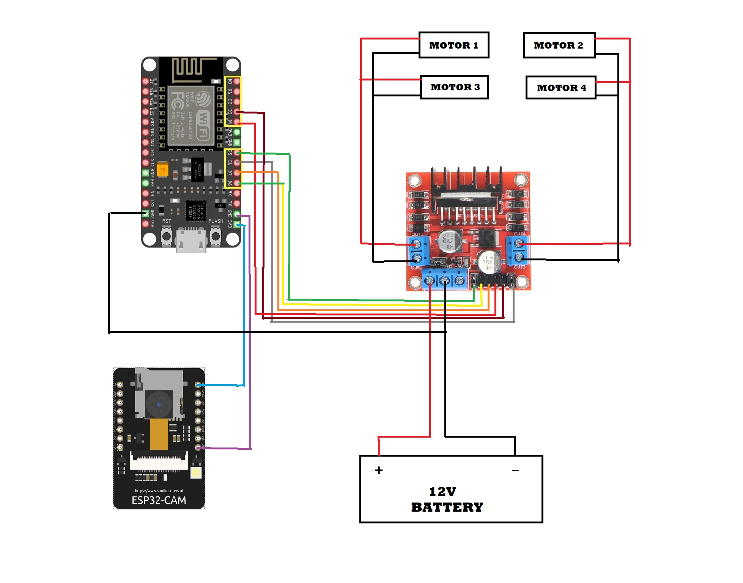
Architecture
Structural Diagram
Block Diagram/Pin Diagram
Material Needed:
1.Chassis
2.L298N Motor Driver Controller
3.12v DC Gear Motor
4.12v 7Ah Lead Acid Battery
5.ESP8266
6.ESP32 Cam Module

Slide 9
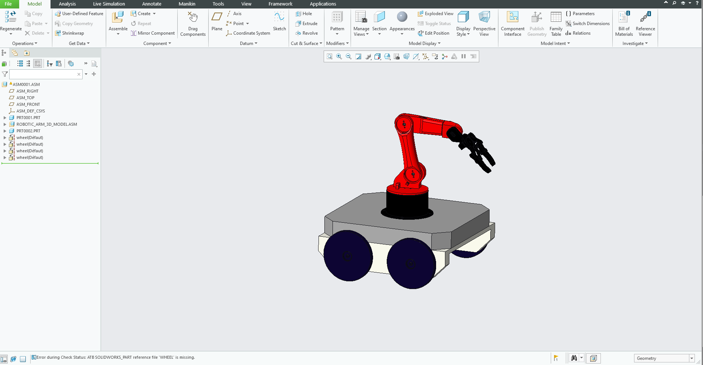
3D Model
Application used: Solidworks CREO

Slide 10
Use Cases & Testing
Use Cases
Order Fulfillment
The robot receives an order via the WMS and autonomously navigates to the required locations.
Inventory Management
The robot scans barcodes on shelves to verify stock levels and sends updates to the WMS.
Sorting and Packing
The robot receives a batch of items and sorts them based on predefined criteria before packing them for shipment.
Restocking
The robot retrieves items from the storage area and places them on shelves that need replenishing, ensuring optimal placement for accessibility.
Hazardous Material Handling
The robot uses its arm to pick and transport hazardous materials while following safety protocols, reducing risk to human workers.
Test Cases
Navigation Accuracy
Ensure the robot can navigate the warehouse without collisions.
Picking and Placing Efficiency
Measure the robot's efficiency in picking and placing items.
Error Handling
Test the robot's response to errors (e.g., item not found).
Integration with WMS
Verify seamless integration with existing warehouse systems.
Battery Life and Charging Efficiency
Assess the robot's operational duration and charging times.

Slide 11
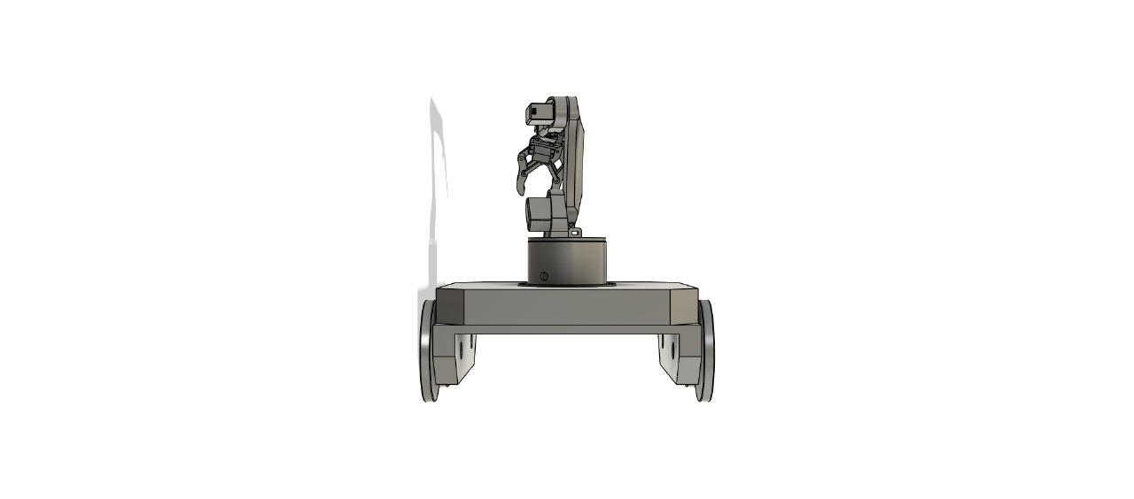
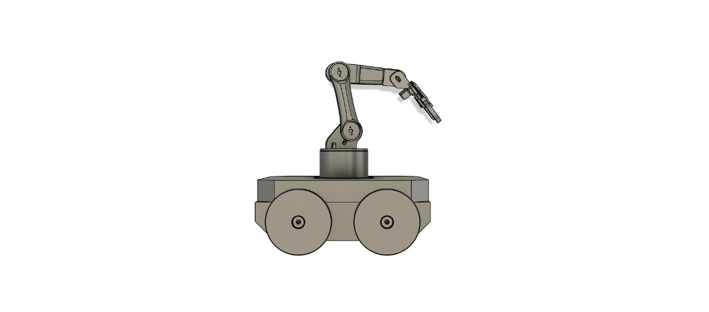
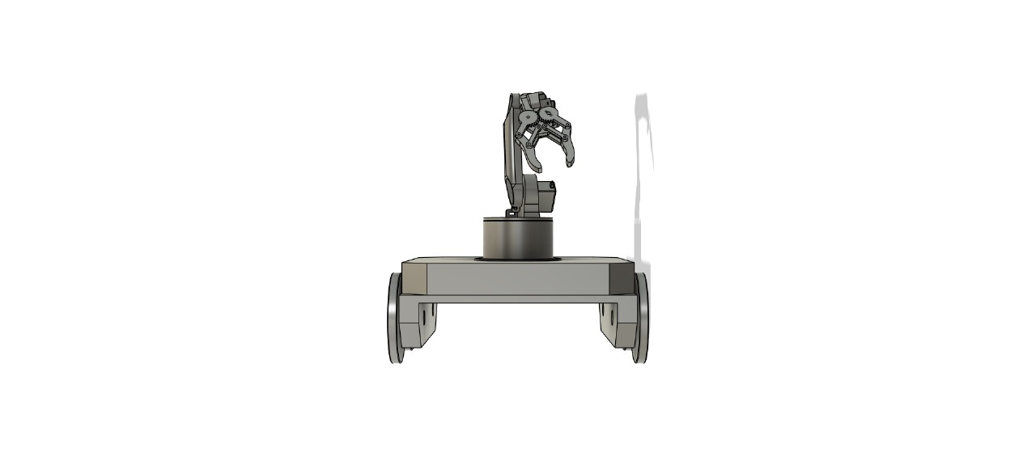
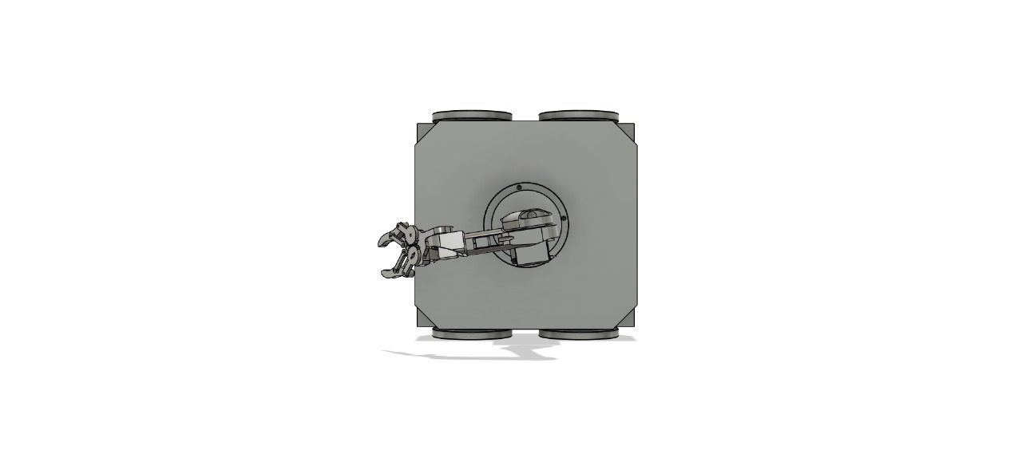
Implementation and Results – Iteration 1
Iteration 1 : Results
We have completed several key steps in our project. First, we created a detailed circuit diagram showing all components and their connections. Next, we finalized the robot design in SolidWorks and ran simulations to identify any mechanical issues. We also setting up the robot's hardware interfaces in ROS and to build a virtual warehouse environment in Gazebo for testing navigation and obstacle avoidance.

Slide 12
Implementation and Results – Iteration 2
We are pleased to report significant progress on our autonomous robot designed for warehouse applications. The base coding has been successfully completed and is functioning optimally, allowing for efficient navigation and control within the warehouse environment. In conjunction with the coding, we have also developed a comprehensive 3D CAD model that accurately represents the robot's design, including its chassis, wheel configuration, and space for future components. This model not only aids in visualizing the robot's structure but also serves as a crucial reference for the assembly and integration of additional features. Moving forward, our focus will shift to designing and coding the robotic arm, which will enable the robot to handle objects effectively. We aim to integrate this arm with the navigation system to achieve full automation, allowing the robot to perform a variety of tasks autonomously, thereby enhancing operational efficiency in the warehouse.

Slide 13
Contribution
Team Progress and Movement
Simulation
Circuit Diagram
Solidworks/ Creo 3D model
Individual Contribution
Key contributions: Suhas S
Circuit Diagram
Solidworks Model
Ros gazebo (in progress)
Key contributions: Prajwal S
Solidworks model
Ros gazebo (in progress)
Key contributions: Navatej M B
Circuit diagram
Behavior diagram

Slide 14
Conclusion & Future Work
Summary and Conclusion
In this project, we have successfully developed the base coding for an autonomous robot with an arm for warehouse applications. The robot is designed to automate tasks like picking, sorting, and moving items, making warehouse operations more efficient and reducing manual labor.
This robot has the potential to improve productivity, safety, and accuracy in warehouses, contributing to a more streamlined and cost-effective operation. Future improvements can focus on enhancing the arm's functionality and integrating more advanced features.
Future Work
In the next phase, we will focus on developing the robotic arm to handle tasks such as picking, sorting, and placing items with greater precision. Additionally, we aim to achieve full automation, allowing the robot to operate independently and adapt to dynamic warehouse conditions. Further enhancements will include optimizing the system’s efficiency, improving accuracy, and integrating sensors and advanced algorithms for better navigation and decision-making. We will also conduct extensive testing to ensure the robot's reliability in various warehouse layouts and real-world scenarios.

Slide 15

THANK YOU

